Slide 1
Introduction to Statistical Methods
ISM Team

Slide 2
Session No: 6
Probability Distributions

Slide 3

IMP Note to Self

Slide 4
Agenda
Distributions:-
Bernoulli
Binomial
Poisson
Normal distributions.
Introduction to t-distribution
Introduction to F-Distribution and
Introduction to Chi Square distributions
4

Slide 5
Introduction
A random experiment that can only have an outcome of either 1 or 0 is known as a Bernoulli trial.
In other words, the random variable can be 1 with a probability p or it can be 0 with a probability (1 - p). Such an experiment is called a Bernoulli trial.
A discrete probability distribution wherein the random variable can only have 2 possible outcomes is known as a Bernoulli Distribution.
5

Slide 6
Bernoulli Distribution
Bernoulli Distribution can be used to describe events that can only have two outcomes, that is, success or failure.
Bernoulli distribution is a special case of binomial distribution when only 1 trial is conducted.
Example:
A pass or fail exam can be modeled by a Bernoulli Distribution.
2) A basketball player can shoot a ball into the basket with a probability of
0.6. What is the probability that he misses the shot?
Solution: We know that success probability P (X = 1) = p = 0.6 Thus, probability of failure is P (X = 0) = 1 - p = 1 - 0.6 = 0.4 The probability he misses the shot is 0.4.
6

Slide 7
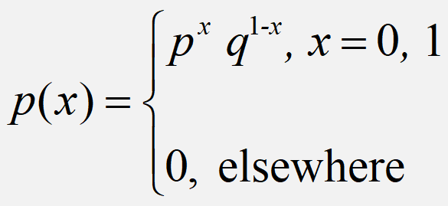
Bernoulli Distribution
A random variable ‘X’ is said to have
Bernouli distribution if its probability mass
function is given by
Definition
This represents a single trial with two possible outcomes (usually labeled as success/failure or 1/0) where success has a probability p and failure has a probability q = 1 - p.
7

Slide 8
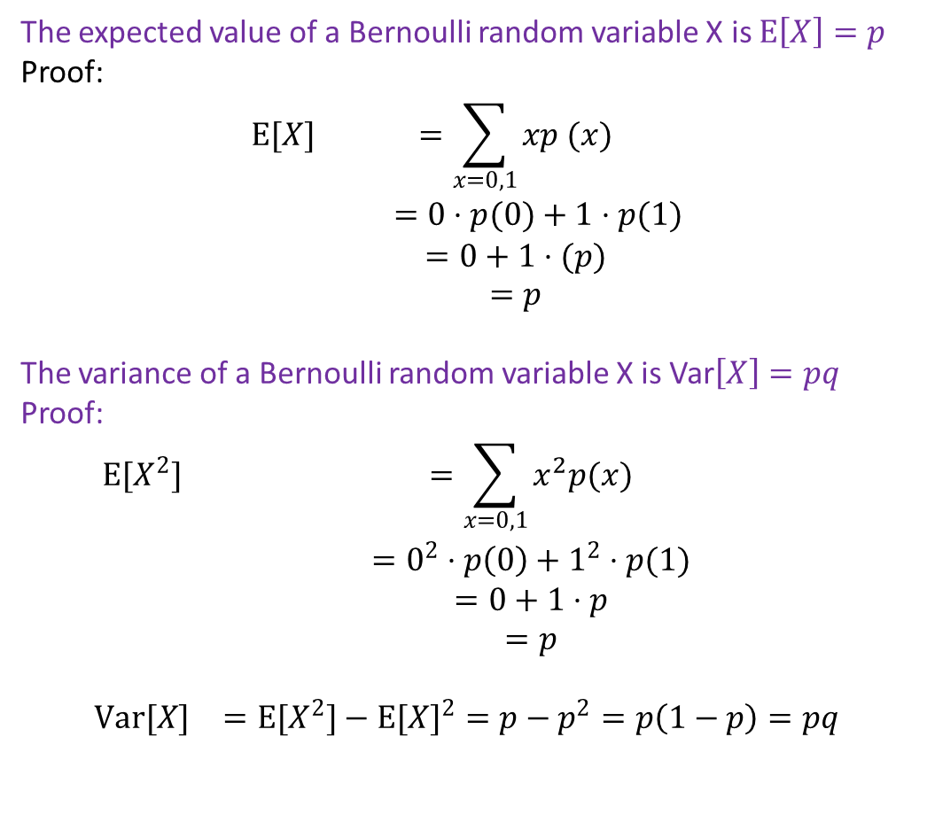
Mean & Variance of Bernoulli distribution
The expected value of a Bernoulli random variable X is $E\left[X\right]=p$
Proof:
$$\begin{matrix}E[X] & =\sum_{x=0,1}{xp (x)} \\ & =0⋅p(0)+1⋅p(1) \\ & =0+1⋅(p) \\ & =p\end{matrix}$$
The variance of a Bernoulli random variable X is Var$\left[X\right]=pq$
Proof:
$$\begin{matrix}E[X^{2}] & =\sum_{x=0,1}{x^{2}p(x)} \\ & =0^{2}⋅p\left(0\right)+1^{2}⋅p(1) \\ & =0+1⋅p \\ & =p \\ & \\ Var[X] & =E[X^{2}]−E[X]^{2}=p−p^{2}=p\left(1−p\right)=pq\end{matrix}$$
8

Slide 9
Bernoulli distribution: Applications
Quality Control: In manufacturing, every product undergoes quality checks. Bernoulli Distribution helps assess whether a product passes (success) or fails (failure) the quality standards.
Market Research: Bernoulli Distribution is useful in surveys and market research when dealing with yes/no questions.
3. Risk Assessment: In the context of risk management, the Bernoulli Distribution can be applied to model events with binary outcomes, such as a financial investment succeeding (success) or failing (failure).
4. Marketing Campaigns: Businesses use Bernoulli Distribution to measure the effectiveness of marketing campaigns.
9

Slide 10
Binomial Distribution
Binomial distribution is a discrete probability distribution.
Binomial distribution will be applied under the following experimental conditions
1) The number of trails (n) is finite
2) The trails are independent of each other
3) The probability of success p is constant for each trail.
4) Each trail results in two mutually exclusive events known as success and failure.
10

Slide 11
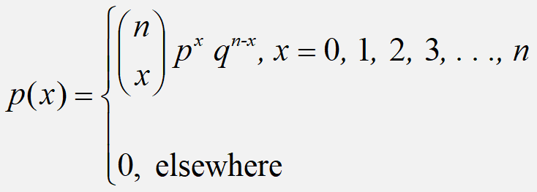
Binomial Distribution
A random variable ‘X’ is said to have
Binomial distribution if its probability mass
function is given by
Definition
It describes the number of successes in a fixed number of independent Bernoulli trials. It involves parameters n (number of trials) and p (probability of success).
11

Slide 12
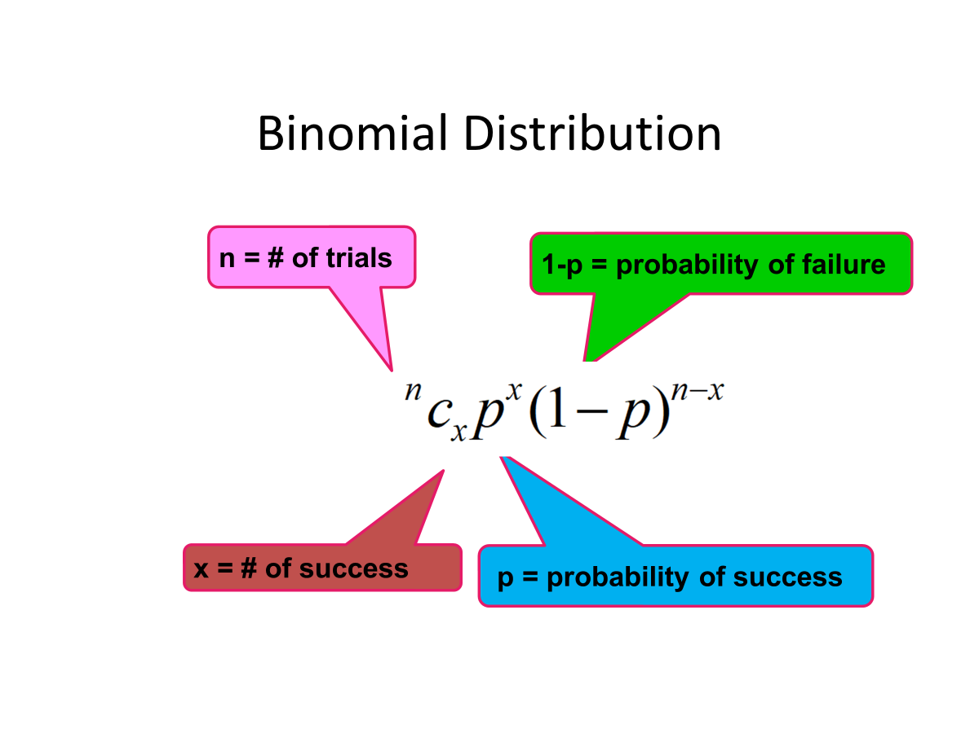
Binomial Distribution
12

Slide 13
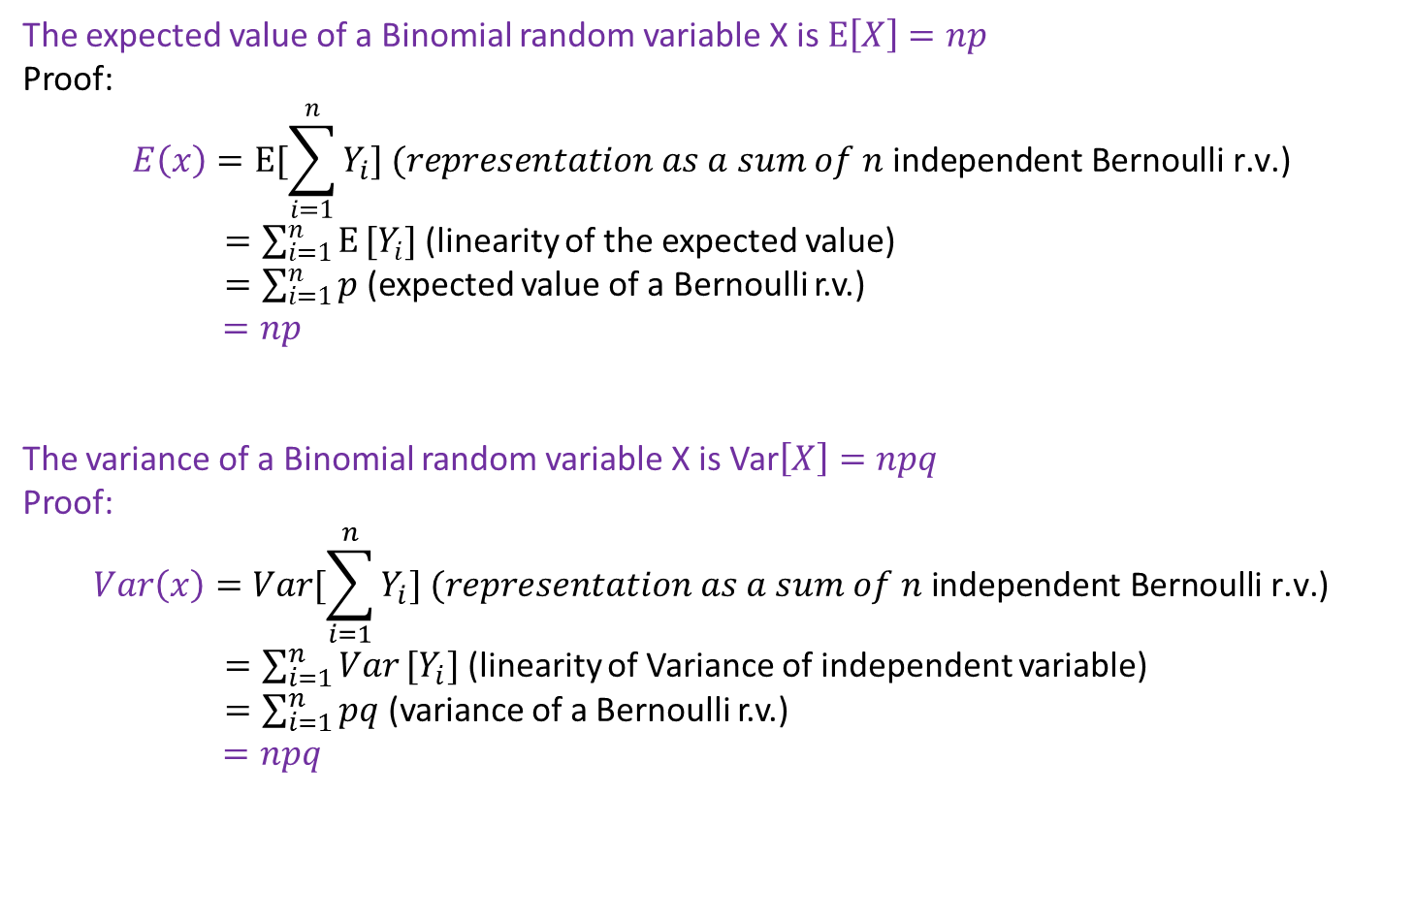
Mean & Variance
The expected value of a Binomial random variable X is $E\left[X\right]=np$
Proof:
$$E\left(x\right)=E[\sum_{i=1}^{n}{Y_{i}}] (representation as a sum of n \text{independent} \text{Bernoulli} \text{r}\text{.}\text{v}\text{.)}$$
$=\sum_{i=1}^{n}{E}[Y_{i}]$ (linearity of the expected value)
$=\sum_{i=1}^{n}{p}$ (expected value of a Bernoulli r.v.)
$=np$
The variance of a Binomial random variable X is Var$\left[X\right]=npq$
Proof:
$$Var\left(x\right)=Var[\sum_{i=1}^{n}{Y_{i}}] (representation as a sum of n \text{independent} \text{Bernoulli} \text{r}\text{.}\text{v}\text{.)}$$
$=\sum_{i=1}^{n}{Var}[Y_{i}]$ (linearity of Variance of independent variable)
$=\sum_{i=1}^{n}{pq}$ (variance of a Bernoulli r.v.)
$=npq$
13

Slide 14
Binomial Distribution-Check:
Which conditions for the binomial distribution, if any, fail to hold in each of the following situations?
(a)The number of persons getting Corona in a room of 30 persons.
Ans: Getting corona is not independent. So, it is not binomial.
(b) Consider 2 out of 20 projectors are defective. We randomly select 3 for testing. Is this a binomial experiment?
Ans: If two defective pieces are in the first two selection, then the result of third is known already. Thus, the event is not independent. So, this is not binomial.
14

Slide 15
Example 1:
In a particular restaurant, an average of 3 out of every 5 customers ask for water with their meal. A random sample of 10 customers is selected. Find the probability that
(i) Exactly 6 ask for water with their meal,
(ii) Less than 9 ask for water with their meal.
(iii) No one asks for water with their meal?
(iv) At most 2 ask for water with their meal?
(v) At least 3 ask for water with their meal?
15

Slide 16
Solution:
n =10 , p = 3/5=0.6, q= 1-p = 0.4
(i) p(6) = 0.251
(ii) p(less than 9) =1- [p(9)+p(10)]= 0.954
(iii) p(0) = 0.0001
(iv) p(at most 2) = p(0) + p(1) + p(2) =0.0001+0.0016+0.0106
= 0.0123
(v) p(at least 3) = p(3)...+ p(10) = 1 – [p(0) + p(1)+ p(2)] = 0.9877
16

Slide 17
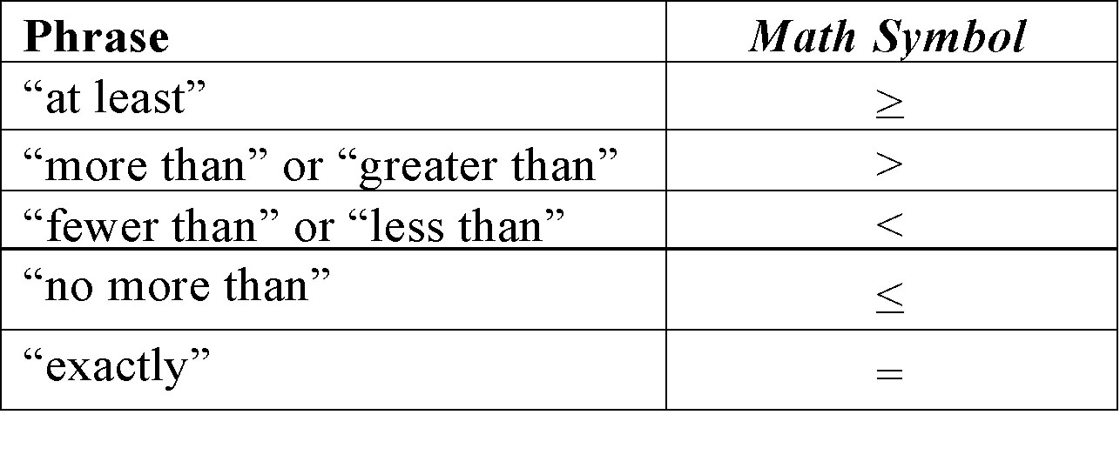
Understandings
17

